Slide 1

Movie Recommendation
System
Pallavi Chandanshive
Akshay Pudage
Sahil Pethe

Slide 2

OUTLINE
Background
Introduction
Project Goals
TMDB Data
Technical Details
System Architecture
Methods and Approach
Data collection
Classification
Results

Slide 3
MOTIVATION
We wanted to use the analysis part which was a requirement in our project as an intermediary step to produce results which can directly influence users. This was the motivation behind creating a movie recommendation system where, based on the dataset and the user’s input, we can recommend a set of movies which would directly influence users’ decisions.

Slide 4
PROJECT GOALS
To develop an analytical recommendation system that analyzes the movie data set and classifies movies which are similar based on their genres, actors, directors, production company and keywords used for search by the user
Creating a front end UI directed at the users for easy interaction
Creating a back end SQL server database for storing/modifying movie entries

Slide 5
TMDB DATA
The TMDB5000 dataset consists of 5000 movies
Having attributes such as movie name, cast, crew, genres, budget, revenue, production countries, production companies, languages
This dataset has a wide variety of movies all the way from the 1930s to the current year

Slide 6
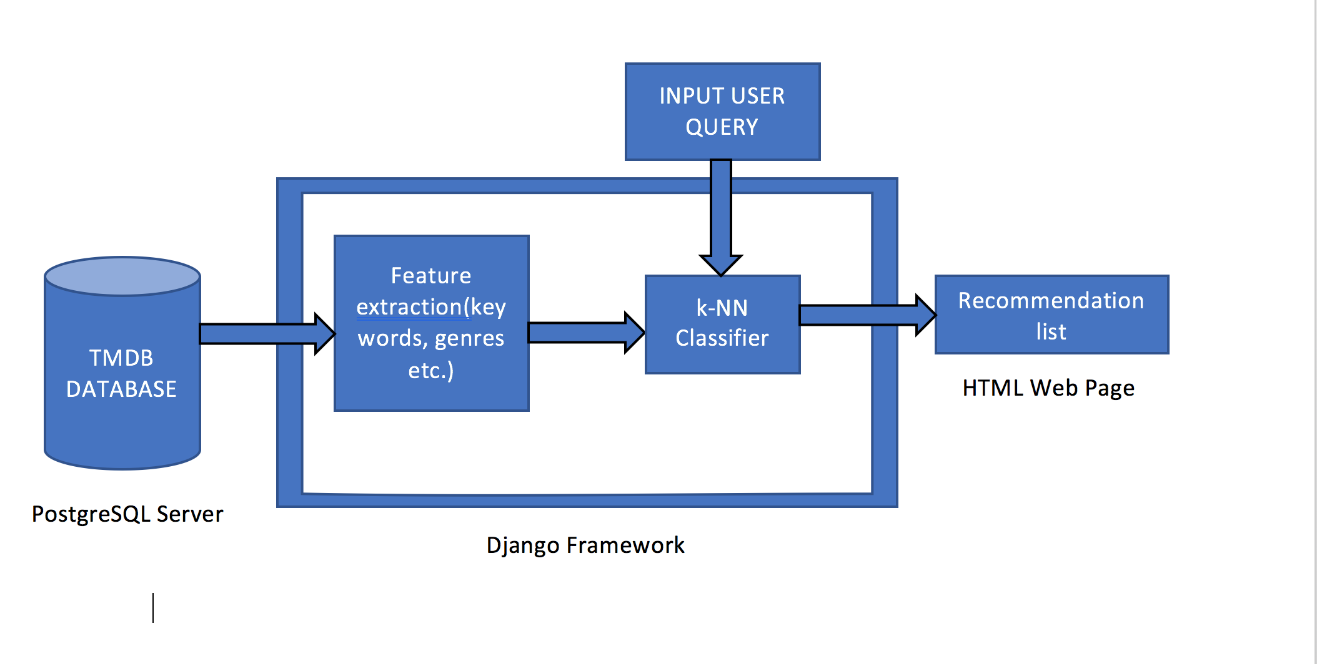
SYSTEM ARCHITECTURE

Slide 7
TOOLS AND TECHNOLOGIES USED
Django server for the front end UI on localhost
PostgreSQL server for hosting the database and handling connections
Pandas library for data manipulation by loading data set into data frames
Psycopg2 for database creation and SQL query execution in python code
Sqlalchemy for loading data from CSV files and storing it in the database, then extracting data from the database to usable data frame format
SciKit library in Python for k-Nearest Neighbor classifier.
Matplotlib library in Python for plotting graphs for visualization.

Slide 8
DATA COLLECTION AND PREPARATION
The dataset was collected from https://www.kaggle.com/tmdb/tmdb-movie-metadata named ‘Tmdb5000’ consisting of 5000 records
The dataset contained nested JSON tags which needed to be structured correctly in CSV format
After removing the nested JSON fields, the obtained CSVs were split into different tables while considering normalization, data redundancy and dependencies and again stored in CSV format
These were then loaded into PostgreSQL server database named ‘tmdb’ after which we can readily add or delete records as and when the system needs

Slide 9
CLASSIFICATION APPROACH
For classification, attributes genre, keywords, top three actors, a director and a production company were used for recommending movies to user.
Metadata of user selected movie is extracted and compared with all the movies in the dataset by building a matrix of binary columns for each metadata. If a metadata column matches, the value for that metadata column is set to 1.
The matrix is then fed to k-Nearest Neighbor classifier which uses Euclidean distance metric to yield 10 similar movies.
These movies are ranked according to the average votes and returned to the frontend to be displayed to the user.
Limited attributes were selected for classification to avoid high computation time.

Slide 10
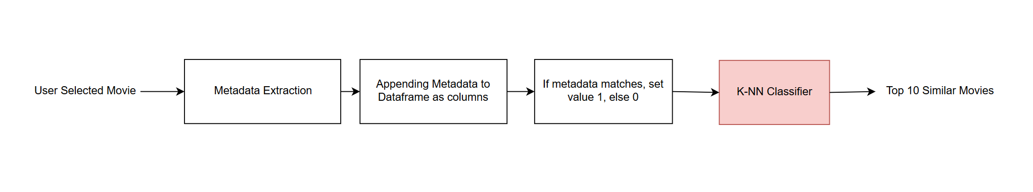
CLASSIFICATION DIAGRAM

Slide 11
RESULT EVALUATION
VISUALIZATION
Top 30 Keywords
Popular Genres
RESULTS
Movie classification based on user's choice from
list of movies available in the drop down using k-NN classifier

Slide 12
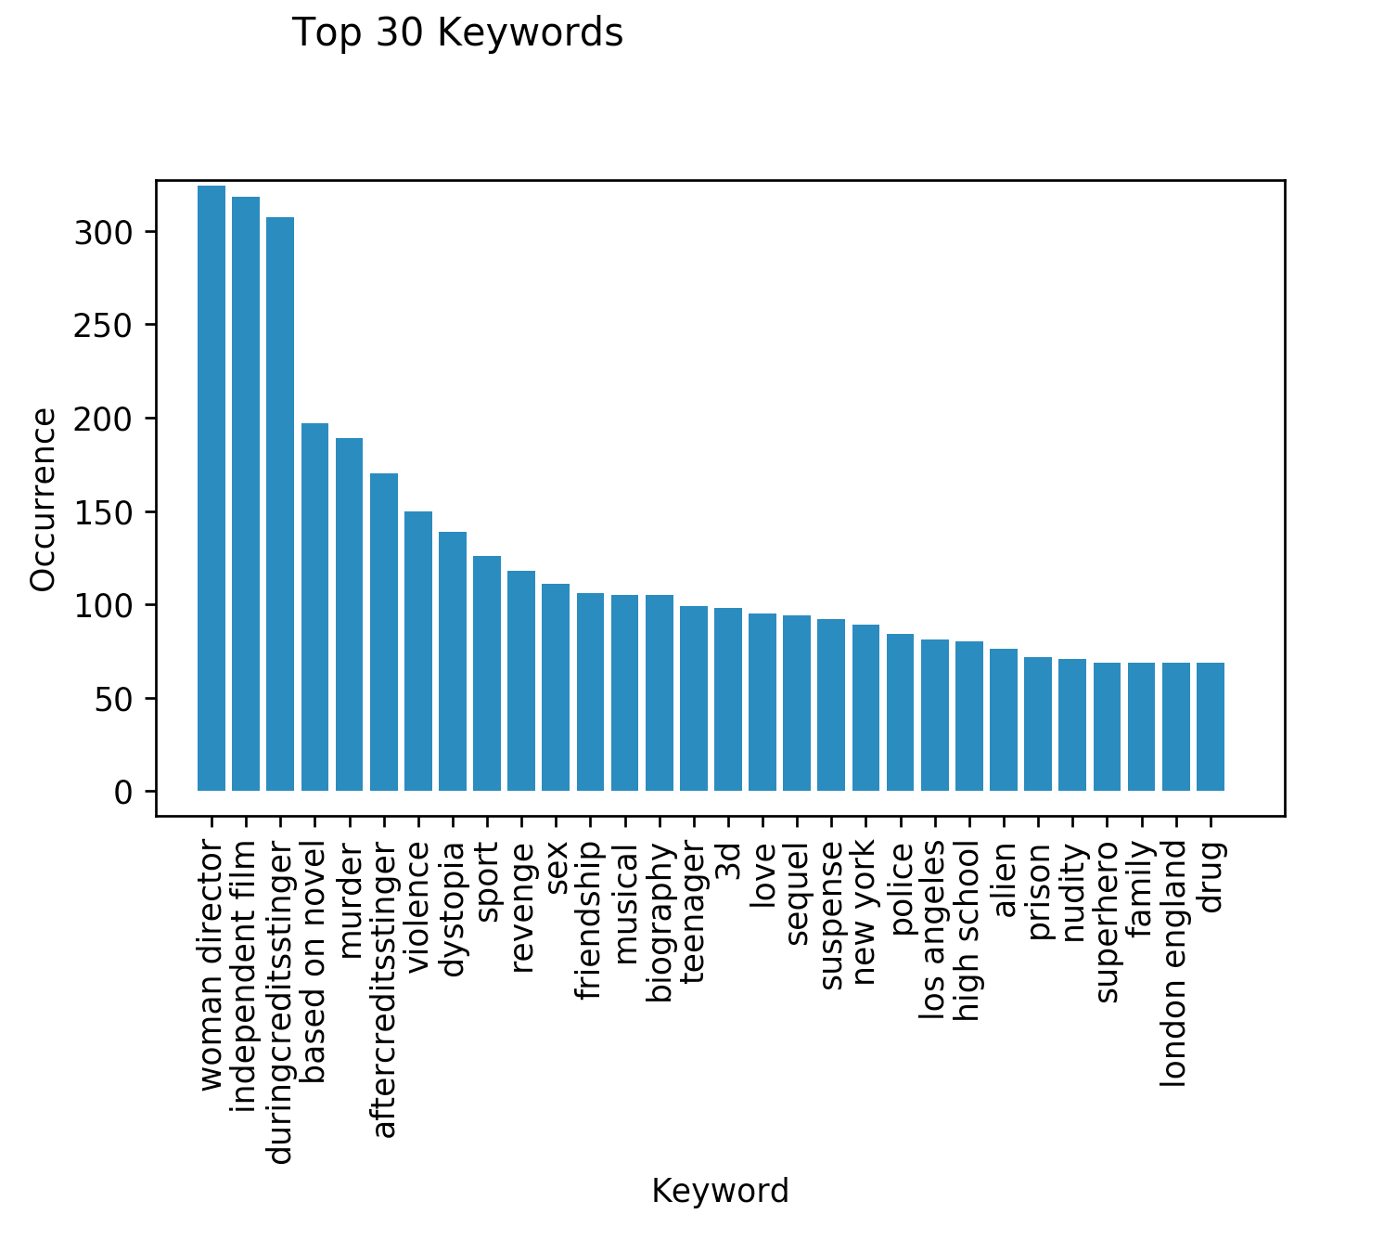
VISUALIZATION FOR 30 KEYWORDS

Slide 13
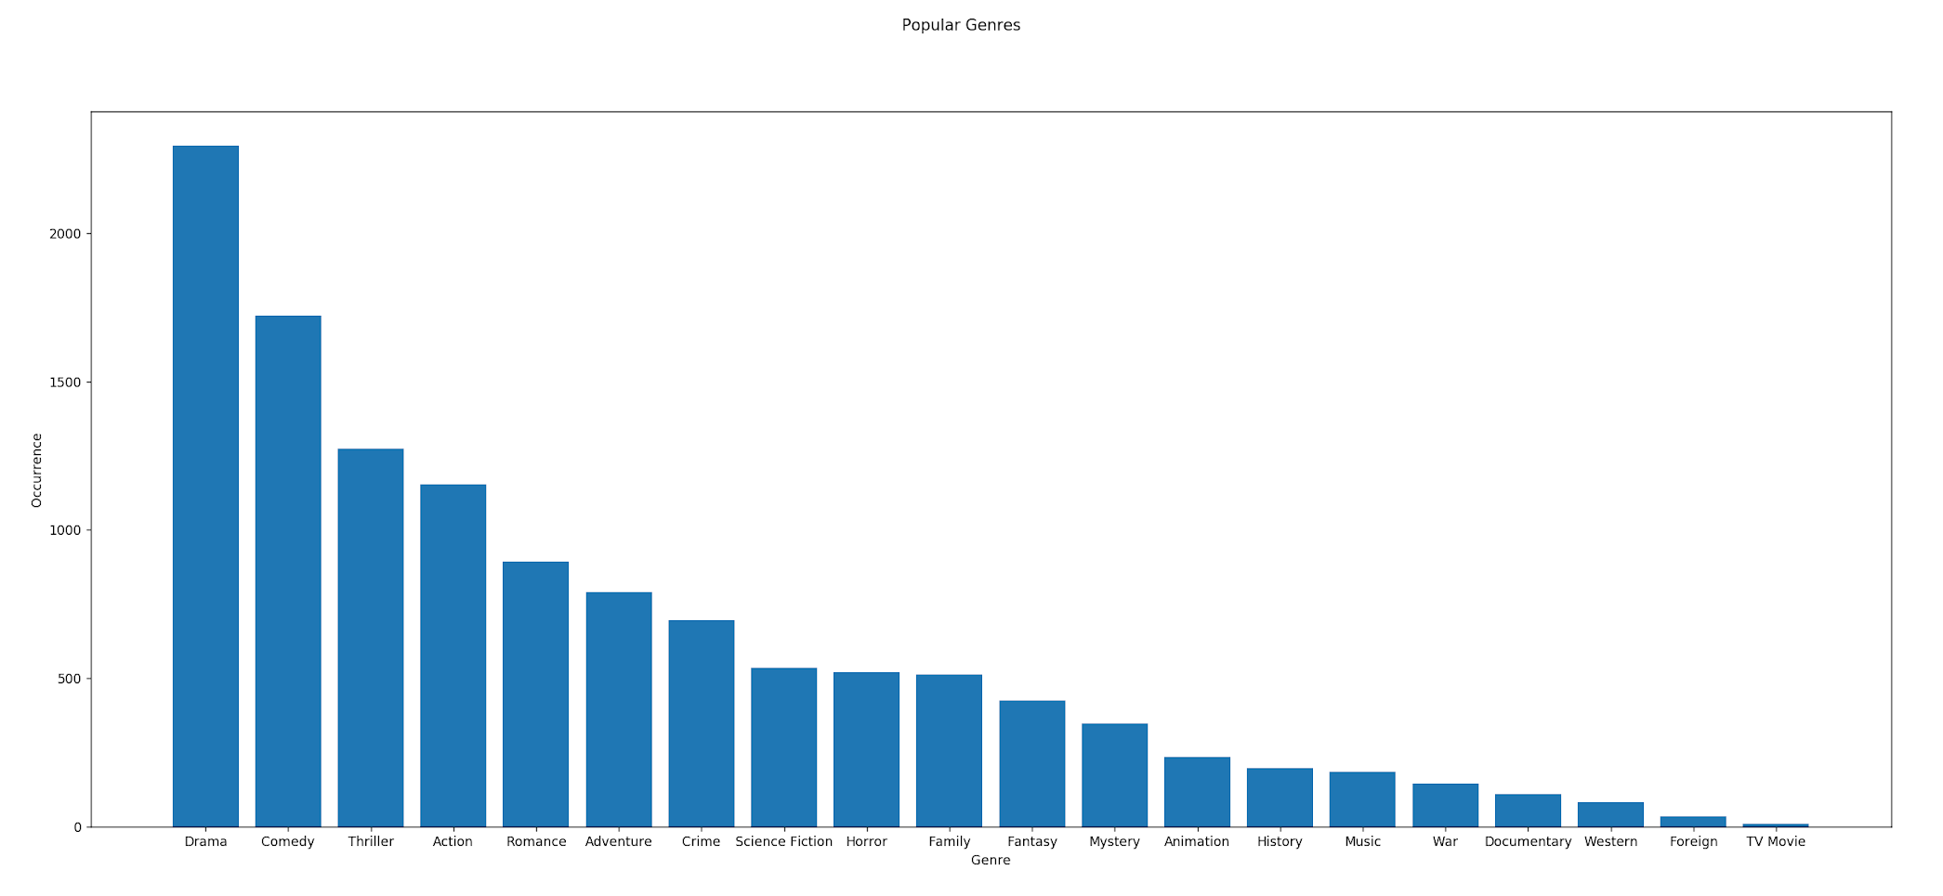
VISUALIZATION FOR POPULAR GENRES

Slide 14
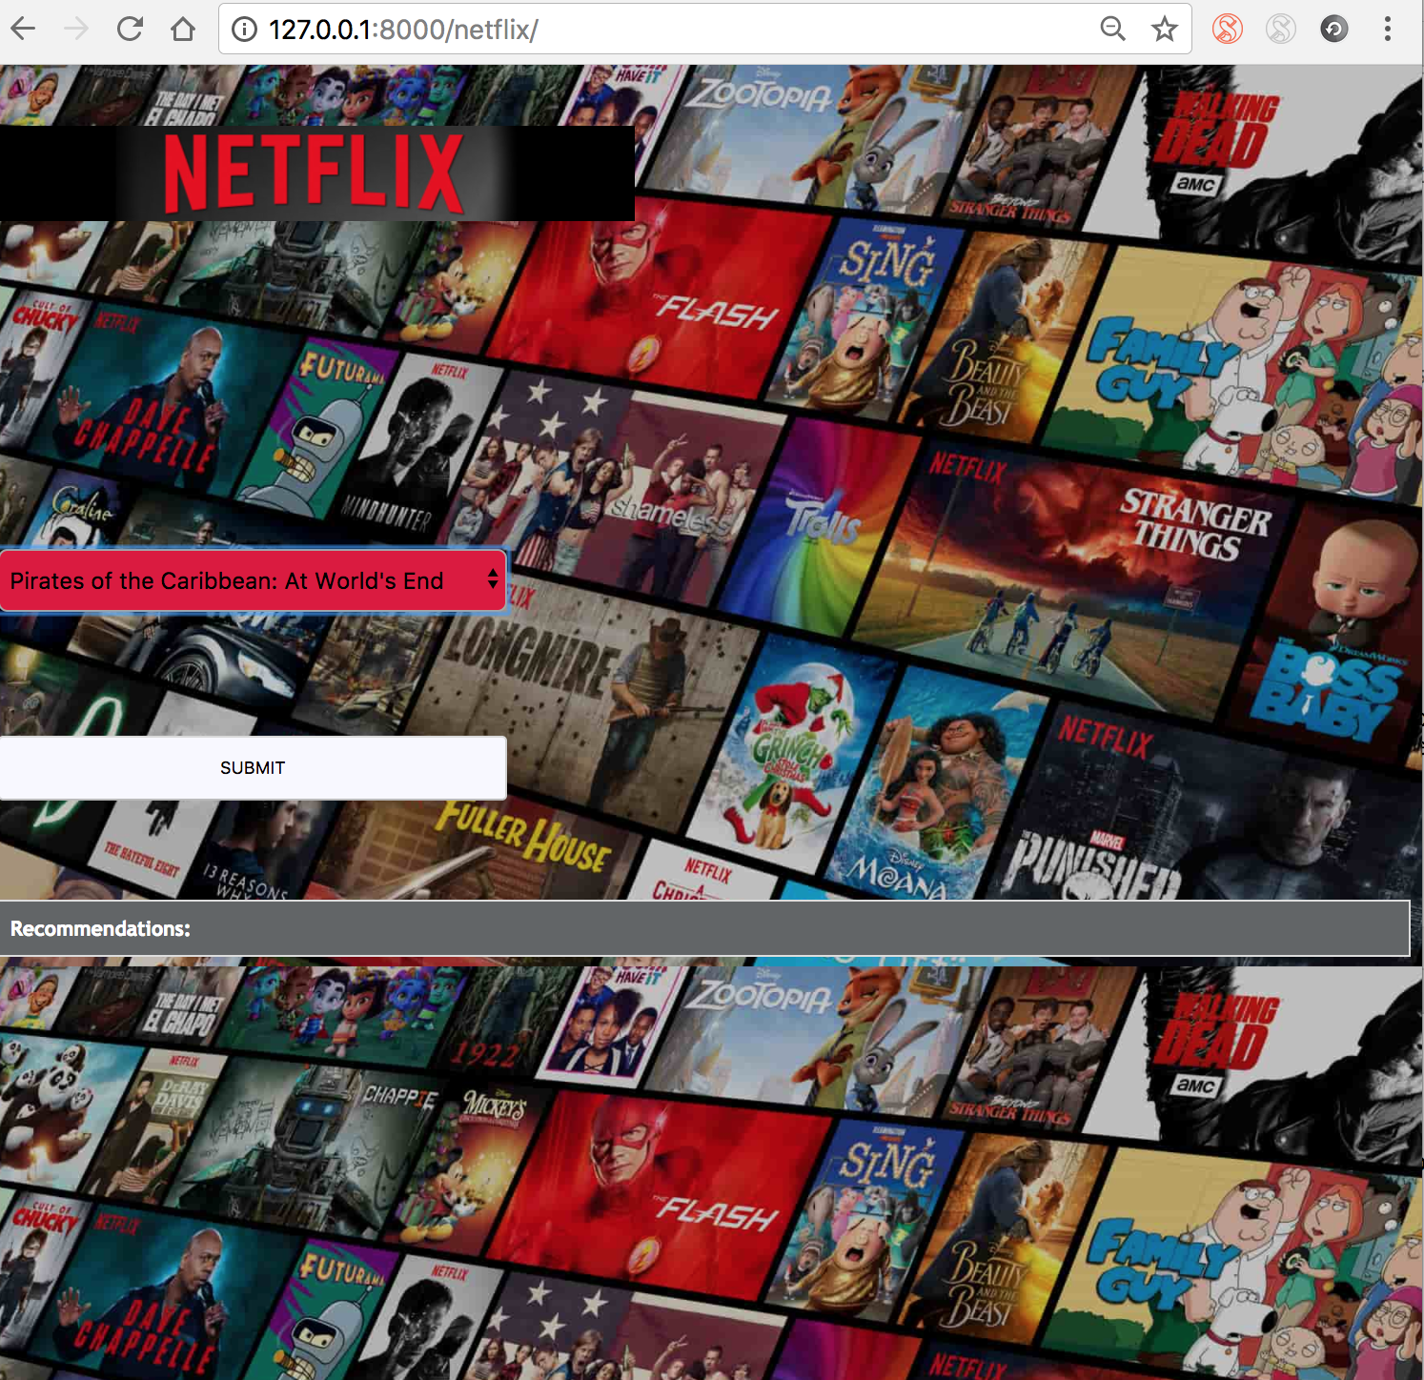
USER QUERY EVALUATION- FRONT END

Slide 15
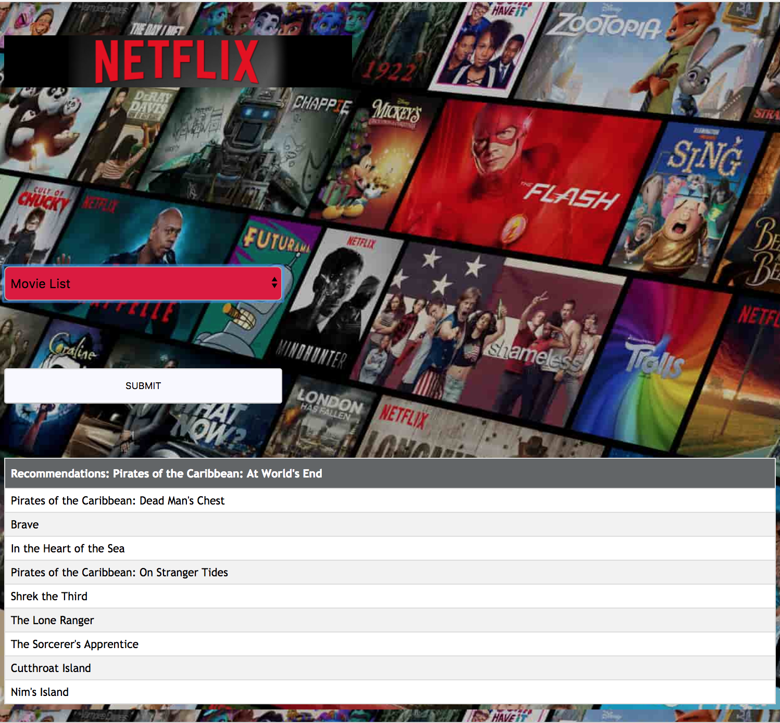
USER QUERY EVALUATION- FRONT END

Slide 16
THANK YOU

